Slide 1
A-G of creative vigor
Beena Gokhale

Slide 2
A: Acceptance
Importance of acceptance
Leads to propelling force rather than strain
Challenge readies you to quantum jump
Helps you to find your greater core strength
Triggers growth and discipline
Makes you tolerant
Empowers your balance
Gives way to compassion
Compassion leads to forgiveness
Forgiveness energizes creative momentum

Slide 3
B: Better nature – Better sense
What disengages you from harmonious behavior?
Why is there a conflict between better nature and better sense
Is better nature more important than better sense?

Slide 4
C: Creation & Collaboration
Does competition leads to creativity?
Should creativity be open to influence?
Could ”B” of help to creation and collaboration?

Slide 5
D: Dreaming & Doing
Dreams begin a new cycle of creation
They bring-in energy of hope and anticipation
They fill-in emptiness in you and you feel youthful in your heart again
They connect you to the irrational and warm up your risk-taking ability
They free your vision and foster your passion
Passion makes you work with dedication – If you can’t find source in passion, ignite it with dedication
Routine won’t look drudgery if you work with passion and dedication
Your good intentions and good work will always bring rewards

Slide 6
E: Emptiness & Enthusiasm
To create afresh, old must go
Satisfaction of past can make you smug and block your progress, growth
Don’t be complacent and overly cautious because of failure
Go for higher achievements build on past experiences
Deliberately keep company of those who have achieved more than you
Emptiness or pain is not always harmful but can provide positive impulse or force

Slide 7
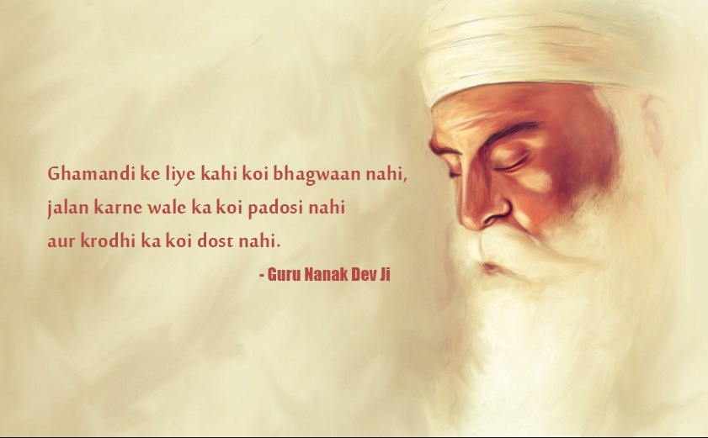

Slide 8
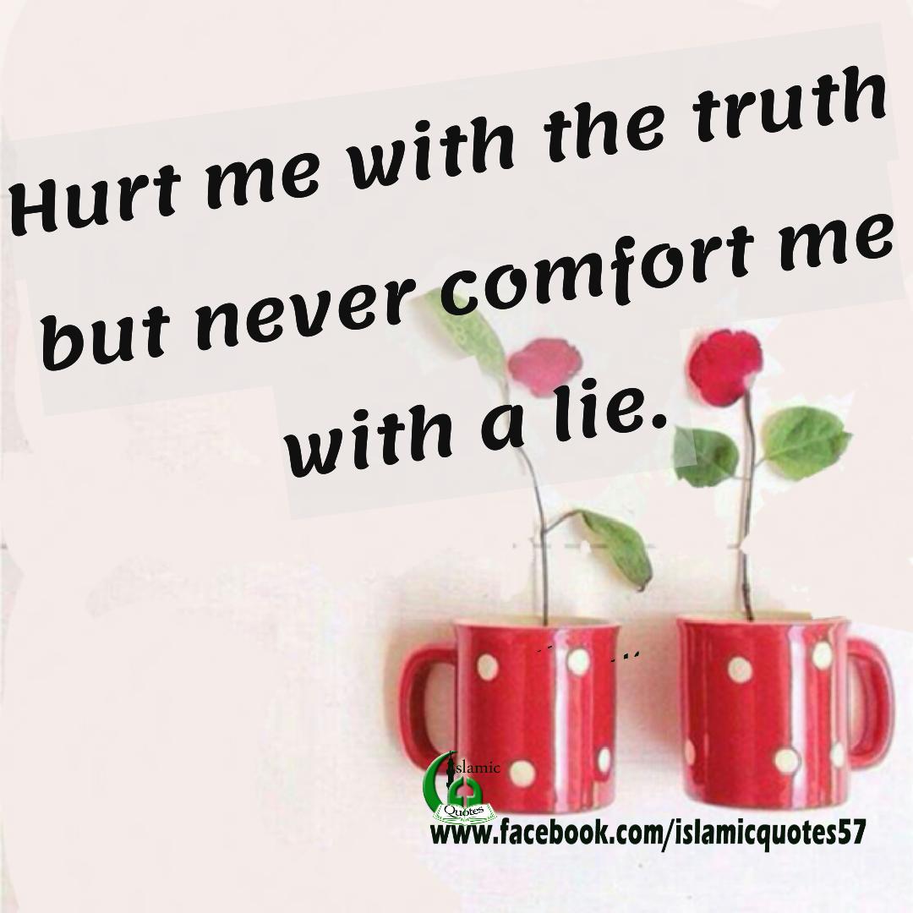

Slide 9
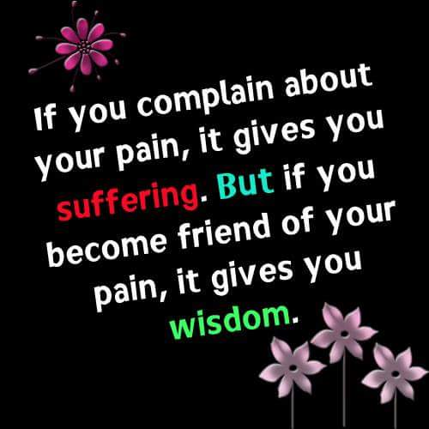

Slide 10
F: Faith
To maintain your morale in your low of emptiness, and to ensure that enthusiasm follows you need an insurance cover called faith
Faith and trust are prime movers of creativity
Foster faith in force of existence
Life moves on invisible wheels of faith
Its is unshakeable, unchallengeable, anchor which keeps you rooted

Slide 11
G: Gratitude & Giving
How is thankfulness different from gratitude?
What are the characteristics of grateful and ungrateful people?
Should possibility of ingratitude should become hindrance in helping others?
How should one give – to whom and in what form?
Should giving be seen superior to taking?

Slide 12
